Slide 1

CAPSTONE PROJECT
ON
HEALTHCARE DATASET
BY
TANUSHREE BOSE AND SUSHMITA KAR
PGPDSBA LVC August 2021

Slide 2


Candidate Introduction
Tanushree Bose
Sushmita Kar

Slide 3
Data
pre-processing
Model tunning
Introduction
Base model
table
Data base
And
Data dictionary
Model selection
And
hyperparameters
Recommendations
Data insight
EDA

Slide 4
INTRODUCTION
Why do we need health insurance policies. 1) To fight heavy expenses caused due to lifestyle diseases.
2) To safeguard family medical cost.
3) To counter inadequate insurance cover.
4) To protect your saving.

Slide 5
Importance of data analysis in health care industry
Insurance company combining internal and external information.
Machine learning makes big data manageable
Using predictive modelling to create sophisticated models.
Deliver a personalized member experience.
Provide right care at the right time.
Fast track claims with predictive modelling

Slide 6

GOAL OF THIS PROJECT
1)To built a cost estimation prediction model.
2)To study variables influencing the insurance cost.
3)Strengthening the insurance cost prediction for the company.

Slide 7
DATA DICTIONARY
Customer is taking policy from the same company since how many years
Number of times customers has done the regular health check up in last one year
Customer is involved with adventure sports like climbing, diving etc
Occupation of the customer
Number of times customer has visited doctor in last one year
Cholesterol level of the customers while applying for insurance
Average daily steps walked by customers
Age of the customer
Any past heart diseases
Any past major diseases apart from heart like any operation
Gender of the customer
Average glucose level of the customer while applying the insurance

Slide 8
DATA DICTIONARY
BMI of the customer while applying the insurance
Smoking status of the customer
When customer have been admitted in the hospital last time
Location of the hospital
Weight of the customer
Customer is covered from any other insurance company
Alcohol consumption status of the customer
Regular exercise status of the customer
How much variation has been seen in the weight of the customer in last year
Fat percentage of the customer while applying the insurance
Total Insurance cost

Slide 9

DATA DESCRIPTION
Total Rows=25000
Total Colum=24
No Duplicate in the dataset.
Missing values in 2 columns BMI and when customer was admitted in hospital last time.
Outliers in few numeric columns BMI and Daily average Steps by customers.

Slide 10
1) Created a new Column ‘Height’, to deal with BMI missing values
2) Dropped ‘Year_of_admitted’ column a) approx. 48% data is missing. a) it’s a year column, and data doesn’t provide record till current year.
3) Weight column shows highly positive correlation with the target variable.
4) Most of the applicants are:
a)Students, b)Male, c)Moderate exercise,
d)Never smoked, e)Rarely consumed alcohol.
Important Data pre-processing steps and Data Insight

Slide 11
Exploratory
Data
Analysis

Slide 12
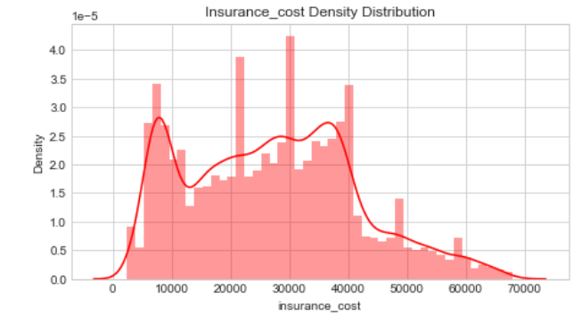
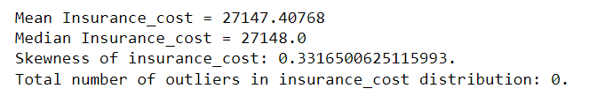
Insurance cost

Slide 13
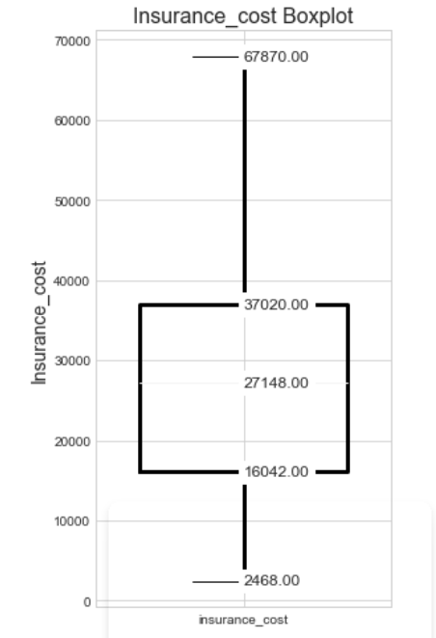
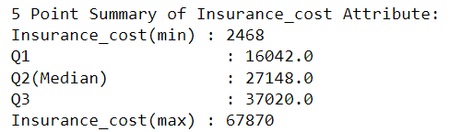
Insurance cost

Slide 14
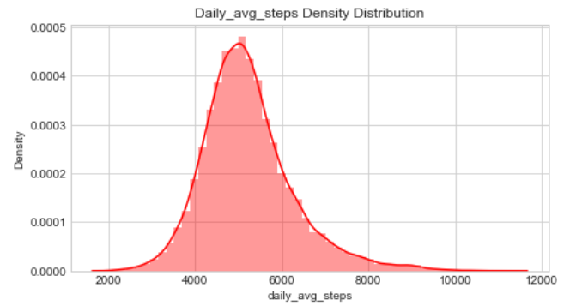
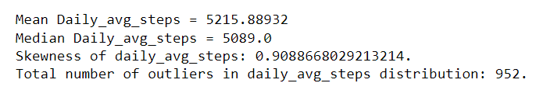
Daily_avg_steps
Presence of outliers
Most steps falls in the brackets of 4k to 6k.

Slide 15
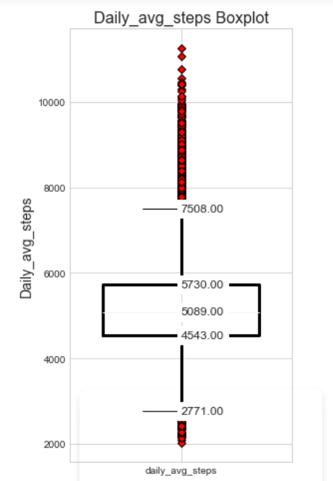
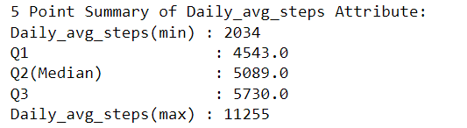
Daily_avg_steps

Slide 16
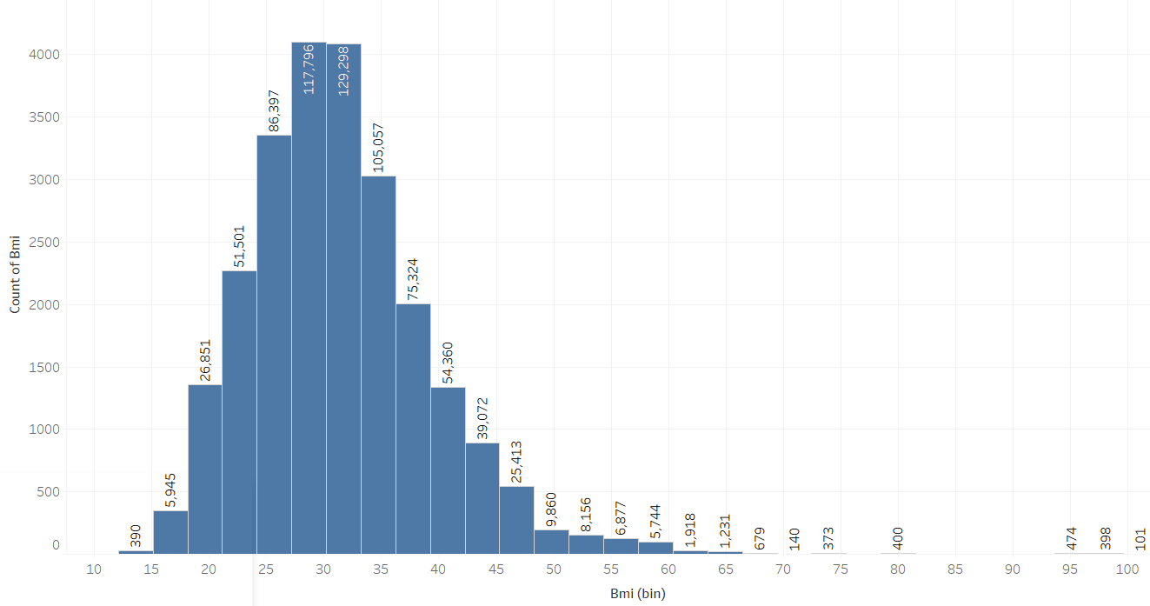
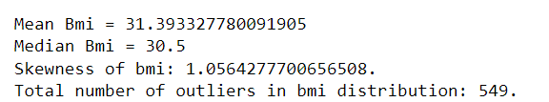
BMI

Slide 17
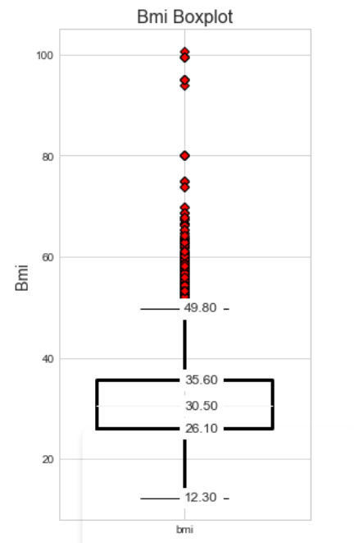
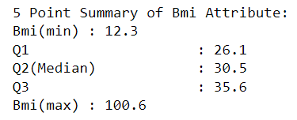
BMI

Slide 18
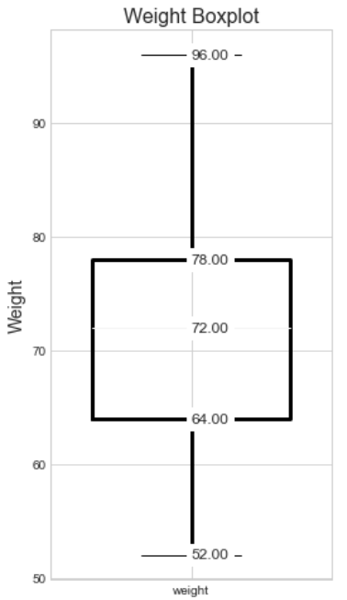
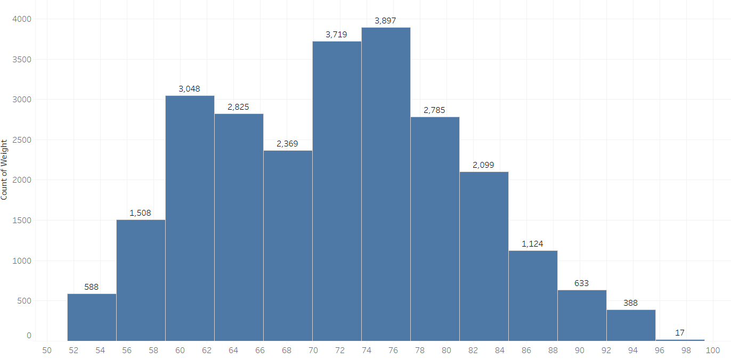

Weight

Slide 19
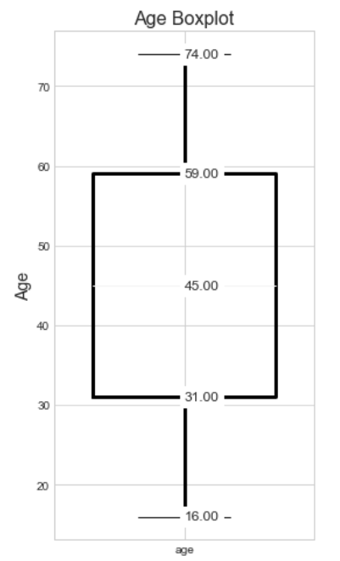
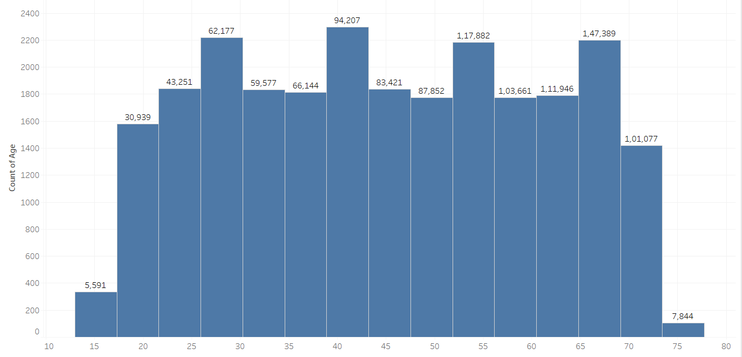
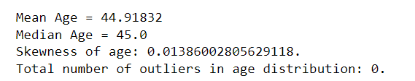
Age

Slide 20
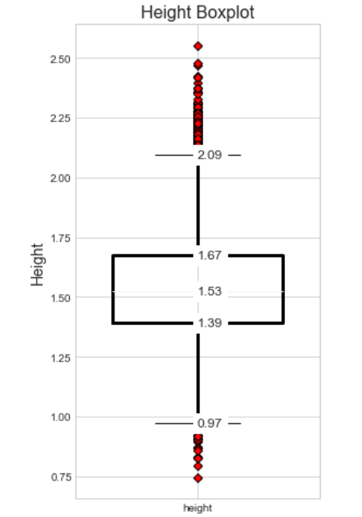
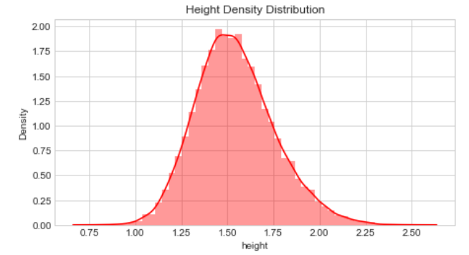
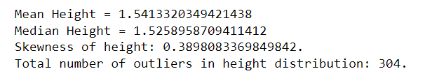
Height

Slide 21
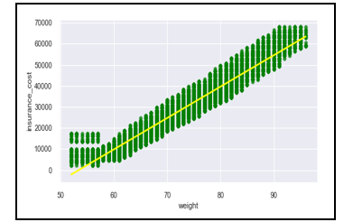
Weight and Insurance cost
Weight highly influencing insurance cost.
Strong positive linear relation.

Slide 22
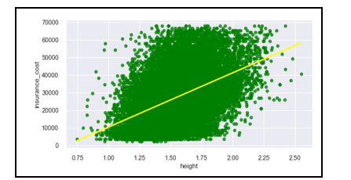
height and Insurance cost
Height is also influencing insurance cost.
We can see presence of outliers.
Positive linear relation.

Slide 23
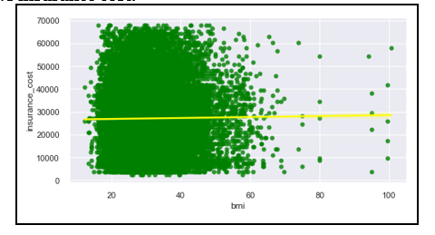
BMI and Insurance cost
BMI is not influencing insurance cost.
We can see presence of outliers.

Slide 24
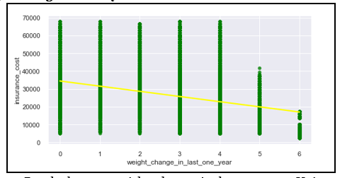
Weight change in last one year and Insurance cost
Weight change is inversely associated with insurance cost
Increased frequency of weight change reduced the insurance cost.

Slide 25
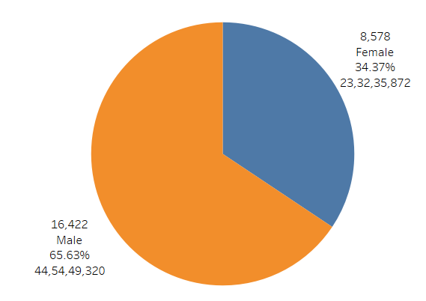
Gender and Insurance cost
Female insurance holder are less.
Company can focus on getting female clients.
Females of childbearing age are more likely to take health insurance.

Slide 26
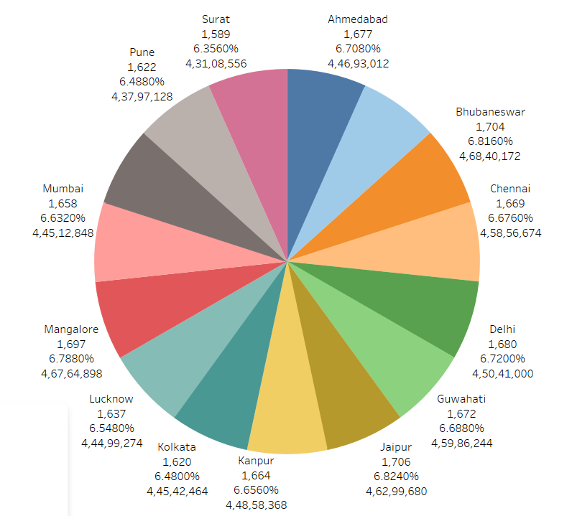
Location and Insurance cost
Insurance cost is equally distributed among all the cities

Slide 27
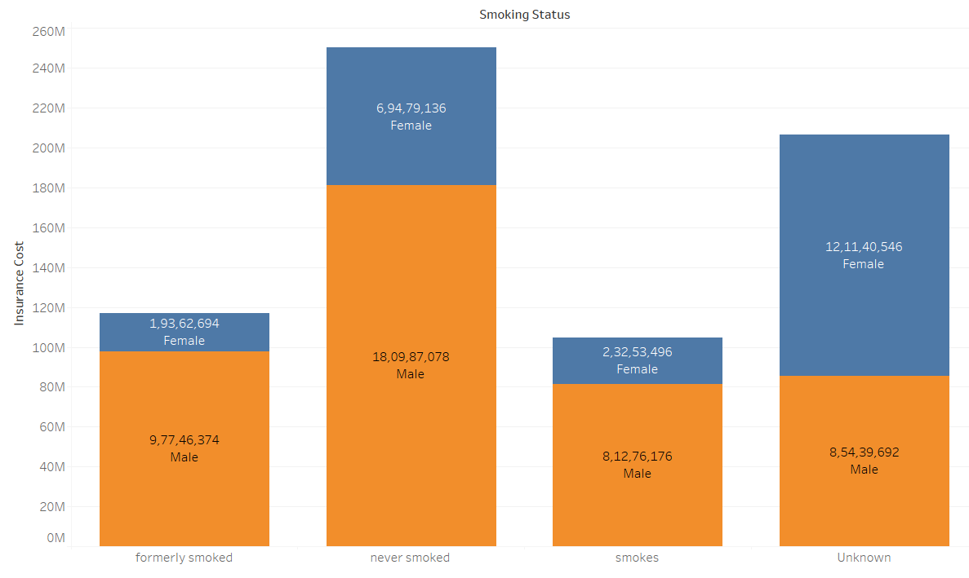
Smoking status, gender and Insurance cost
In unknown category females are more.
Customers who never smoked are paying higher insurance cost

Slide 28
Model Building

Slide 29
Data Evaluation on Baseline Model
Model Name | Train Error | Test Error | RMSE Train Error | RMSE Test Error
Linear Regression | 0.949761 | 0.949936 | 2.24E-01 | 0.222788
Decision Tree | 1 | 0.909335 | 3.13E-17 | 0.299811
Lasso | 0 | -0.000184 | 1.00E+00 | 0.995789
Ridge | 0.949757 | 0.94994 | 2.24E-01 | 0.222779
Random Forest | 0.993238 | 0.951199 | 8.23E-02 | 0.219958
AdaBoost Regressor | 0.947336 | 0.947702 | 2.30E-01 | 0.227704
Gradient Boosting | 0.955841 | 0.954789 | 2.10E-01 | 0.211715
XGB Regressor | 0.973696 | 0.952063 | 1.62E-01 | 0.218004
MLP Regressor | 0.968709 | 0.938206 | 1.77E-01 | 0.247513
Bagging | 0.990688 | 0.946764 | 9.66E-02 | 0.229736

Slide 30
Random Forest Regressor
Final Model Selected
Gradient Boosting Regressor
XGB Regressor

Slide 31
HYPERPARAMETERS USED WHILE TUNING THE MODELS FOR BETTER SCORES
Random Forest Regressor
max_depth
Max_features
Min_samples_split
Min_samples_leaf
Gradient Boosting Regressor
N_estimator
Max_depth
Min_samples_split
Min_samples_leaf
Learning_rate
XGB Regressor
max_depth
Min_child_weight
subsample
Cosample_bytree
Alpha

Slide 32
Model Performance with Hyperparameter | Train Error | Test Error | RMSE Train Error | RMSE Test Error
GB:I1 | 0.95008 | 0.94446 | 0.223669 | 0.234653
GB:I2 | 0.949 | 0.94118 | 0.226062 | 0.241477
GB:I3 | 0.94028 | 0.93529 | 0.244627 | 0.253285
GB:I4 | 0.95588 | 0.95488 | 0.210281 | 0.211495
GB:I5 | 0.95592 | 0.95471 | 0.210181 | 0.211908
GRADIENT BOOSTING REGRESSOR

Slide 33
Model Performance using Iteration | Train Error | Test Error | RMSE Train Error | RMSE Test Error
RF:I1 | 0.956481 | 0.953254 | 0.208833 | 0.215278
RF:I2 | 0.956428 | 0.953289 | 0.208959 | 0.215197
RANDOM FOREST REGRESSOR

Slide 34
Model Performance using Iteration | Train Error | Test Error | RMSE Train Error | RMSE Test Error
XGB:I1 | 0.955805 | 0.954798 | 0.210448 | 0.211693
XGB:I2 | 0.955805 | 0.954798 | 0.210448 | 0.211693
XGB REGRESSOR

Slide 35
Advantage of Selected Models
Fast and Efficient on large dataset.
These models can handle binary, continuous and categorical data.
Often provides predictive accuracy which can not be trumped.
These Models are very Flexible and requires less data pre-processing- which helps the machine to implement these models faster with less complexity.
Missing data is one of the issues while training a model. These models handles the missing data on its own and does not require us to handle it explicitly.

Slide 36
Insights From EDA and
model building

Slide 37
Important features from model building : weight, daily avg steps, bmi, insurance covered by other company.
Insurance cost is directly connected to the lifestyle of the customer.
Weight most important feature.
To understand the insurance cost.
Only 15% customers are smokers. More than 7000 customers smoking habit is unknown.
Change in BMI is not effecting the insurance cost of the customer.
Location is not playing any importance in the insurance cost.
Age is an important factor but its not affecting the insurance cost here.
Only 10% of the customers are consuming alcohol daily.

Slide 38
Recommendations

Slide 39
Higher insurance cost for different location. Metro cities have higher medical cost than small cities.
Higher the age, the insurance cost must be higher. Older people needs more medical facilities in general.
Company must look into the occupation for insurance cost. Premium must be higher for customers working in risky work environment.
Customers with high bmi are at risk of serious ailments, based on their bmi company must charge the insurance cost.
Company must get data of the dependent applicants. Insurance cost must be higher for plans that covers spouses/ dependents.
Company should acknowledge its old customers, by offering free health check-up and discounted premium amounts.

Slide 40
Annual check-up must be given to the customers for better record handling.
Company must target females of childbearing age, as they are more likely to insure their medical expenses.
People involved in adventure sports pay good premium to insure them selves, company must target them.
Overall weight distributing is normal, but the bmi is showing lots of obese customers. The company needs to look into the records for verification.

Slide 41
THANK YOU

